Slide 1
Polyalphabetic Cipher Md. Alamgir Hossain Senior Lecturer, Dept. of CSE, Prime University Mail: alamgir.cse14.just@gmail.com

Slide 2

Polyalphabetic Cipher
Polyalphabetic Cipher is a substitution cipher in which the cipher alphabet for the plain alphabet may be different at different places during the encryption process.
The next two examples, playfair and Vigenere Cipher are polyalphabetic ciphers.

Slide 3
Playfair Cipher
In this scheme, pairs of letters are encrypted, instead of single letters as in the case of simple substitution cipher.
In playfair cipher, initially a key table is created. The key table is a 5×5 grid of alphabets that acts as the key for encrypting the plaintext. Each of the 25 alphabets must be unique and one letter of the alphabet (usually J) is omitted from the table as we need only 25 alphabets instead of 26. If the plaintext contains J, then it is replaced by I.

Slide 4

Encryption Steps of Playfair Cipher
Remove any punctuation or characters that are not present in the key square (this may mean spelling out numbers, punctuation etc.).
Identify any double letters in the plaintext and replace the second occurrence with an ‘x’ e.g. ‘hammer’ -> ‘hamxer’.
If the plaintext has an odd number of characters, append an ‘x’ to the end to make it even.
Break the plaintext into pairs of letters, e.g. “hamxer” -> “ha mx er”, key is monarchy.
The algorithm now works on each of the letter pairs.
Locate the letters in the key square.
If the letters are in different rows and columns, replace the pair with the letters on the same row respectively but at the other pair of corners of the rectangle defined by the original pair. The order is important – the first encrypted letter of the pair is the one that lies on the same row as the first plaintext letter. ‘ha’ -> ‘bo’, ‘es’ -> ‘il’
If the letters appear on the same row of the table, replace them with the letters to their immediate right respectively (wrapping around to the left side of the row if a letter in the original pair was on the right side of the row). ‘ma’ -> ‘or’, ‘lp’ -> ‘pq’
If the letters appear on the same column of the table, replace them with the letters immediately below respectively (wrapping around to the top side of the column if a letter in the original pair was on the bottom side of the column). ‘rk’ -> ‘dt’, ‘pv’ -> ‘vo’

Slide 5
Encryption Steps of Playfair Cipher
An example encryption, “we are discovered, save yourself” using the key square
Keyword: “monarchy”
Plaintext: “wearediscoveredsaveyourselfx”
Ciphertext: “ugrmkcsxhmufmkbtoxgcmvatluiv”

Slide 6
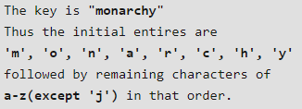
Playfair Cipher Encryption Algorithm
The Algorithm consists of 2 steps: Key->monarchy, Plaintext: instruments
Generate the key Square(5×5):
The key square is a 5×5 grid of alphabets that acts as the key for encrypting the plaintext. Each of the 25 alphabets must be unique and one letter of the alphabet (usually J) is omitted from the table (as the table can hold only 25 alphabets). If the plaintext contains J, then it is replaced by I.
The initial alphabets in the key square are the unique alphabets of the key in the order in which they appear followed by the remaining letters of the alphabet in order.
Example:

Slide 7
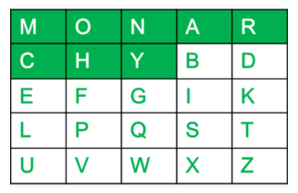
Playfair Cipher Encryption Algorithm
The Algorithm consists of 2 steps: Key->monarchy, Plaintext: instruments
Generate the key Square(5×5):
The key square is a 5×5 grid of alphabets that acts as the key for encrypting the plaintext. Each of the 25 alphabets must be unique and one letter of the alphabet (usually J) is omitted from the table (as the table can hold only 25 alphabets). If the plaintext contains J, then it is replaced by I.
The initial alphabets in the key square are the unique alphabets of the key in the order in which they appear followed by the remaining letters of the alphabet in order.
Example:

Slide 8

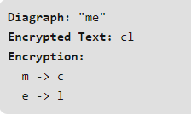
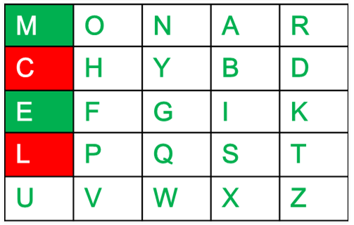
Playfair Cipher Encryption Algorithm
Algorithm to encrypt the plain text: The plaintext is split into pairs of two letters (digraphs). If there is an odd number of letters, a Z/X is added to the last letter.
For example:
Rules for Encryption:
If both the letters are in the same column: Take the letter below each one (going back to the top if at the bottom). For example:

Slide 9
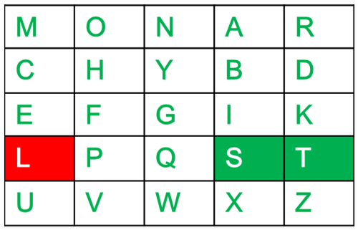
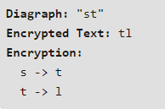
Playfair Cipher Encryption Algorithm
If both the letters are in the same row: Take the letter to the right of each one (going back to the leftmost if at the rightmost position).
For example:

Slide 10
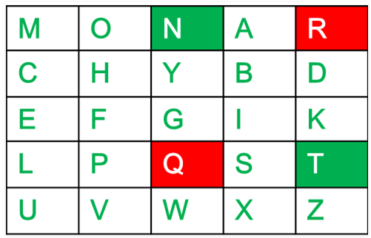
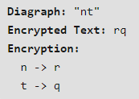
Playfair Cipher Encryption Algorithm
If neither of the above rules is true: Form a rectangle with the two letters and take the letters on the horizontal opposite corner of the rectangle.
For example:

Slide 11
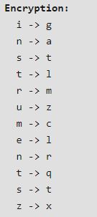
Playfair Cipher Encryption Technique
Example:
Plain Text: “instrumentsz”
Encrypted Text: “gatlmzclrqtx”

Slide 12
Playfair Cipher Decryption Technique
Decrypting the Playfair cipher is as simple as doing the same process in reverse. The receiver has the same key and can create the same key table, and then decrypt any messages made using that key.
Key: monarchy(Same key is used for both Encryption & Decryption)
The Algorithm consists of 2 steps:
Generate the key Square(5×5) at the receiver’s end:
The key square is a 5×5 grid of alphabets that acts as the key for encrypting the plaintext. Each of the 25 alphabets must be unique and one letter of the alphabet (usually J) is omitted from the table (as the table can hold only 25 alphabets). If the ciphertext contains J, then it is replaced by I.
The initial alphabets in the key square are the unique alphabets of the key in the order in which they appear followed by the remaining letters of the alphabet in order.

Slide 13

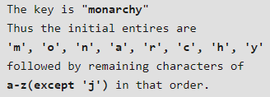

Playfair Cipher Decryption Technique
Algorithm to decrypt the ciphertext: The ciphertext is split into pairs of two letters (digraphs).
Example:

Slide 14
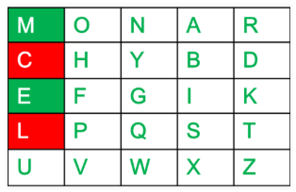
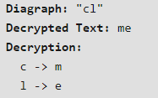
Playfair Cipher Decryption Technique
Rules for Decryption:
If both the letters are in the same column: Take the letter above each one (going back to the bottom if at the top).
For example:

Slide 15
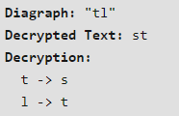
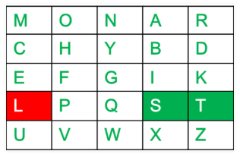
Playfair Cipher Decryption Technique
If both the letters are in the same row: Take the letter to the left of each one (going back to the rightmost if at the leftmost position).
For example:

Slide 16
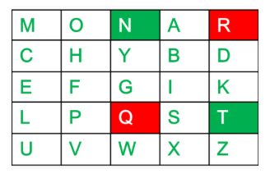
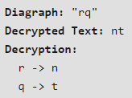
Playfair Cipher Decryption Technique
If neither of the above rules is true: Form a rectangle with the two letters and take the letters on the horizontal opposite corner of the rectangle.
For example:

Slide 17
Playfair Cipher Decryption Technique
Cipher Text: gatlmzclrqtx
Decrypted Text: instrumentsz
Decryption:
ga -> in
tl -> st
mz -> ru
cl -> me
rq -> nt
tx -> sz

Slide 18
Playfair Cipher Encryption (Example)
Plain Text: “I AM A STUDENT”
Keyword: “EDUCATION”
Encrypted Text: “BDSEMBCUCTOV”

Slide 19
Advantages & Disadvantages of Playfair Cipher
Advantages:
It is significantly harder to break since the frequency analysis technique used to break simple substitution ciphers is difficult but still can be used on (25*25) = 625 digraphs rather than 25 monographs which is difficult.
Frequency analysis thus requires more cipher text to crack the encryption.
Disadvantages:
An interesting weakness is the fact that a digraph in the ciphertext (AB) and it’s reverse (BA) will have corresponding plaintexts like UR and RU (and also ciphertext UR and RU will correspond to plaintext AB and BA, i.e. the substitution is self-inverse). That can easily be exploited with the aid of frequency analysis, if the language of the plaintext is known.
Another disadvantage is that playfair cipher is a symmetric cipher thus same key is used for both encryption and decryption.

Slide 20
Vigenere Cipher
The vigenere cipher is an algorithm that is used to encrypt and decrypt the text.
It is used for encrypting an alphabetic text that uses a series of interwoven Caesar ciphers.
It is based on a keyword’s letters.
It is an example of a polyalphabetic substitution cipher.
Two methods perform the vigenere cipher.

Slide 21
Vigenere Cipher (Method-01)
It uses a Vigenere table or Vigenere square for encryption and decryption of the text.
The vigenere table is also called the tabula recta.
The Vigenère cipher uses a 26×26 table with A to Z as the row heading and column heading.
When the vigenere table is given, the encryption and decryption are done using the vigenere table (26 * 26 matrix) in this method.

Slide 22
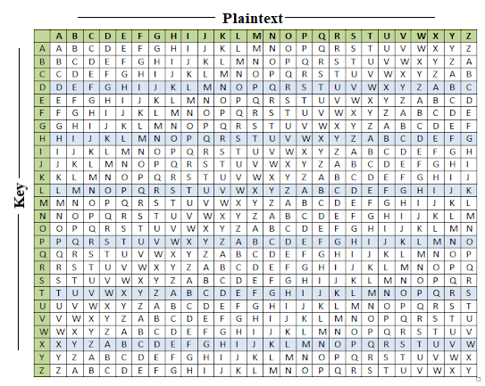
Vigenere Table

Slide 23
Vigenere Cipher
To the plaintext, the Vigenère cipher also requires a keyword, which is repeated so that the total length is equal to that of the plaintext.
For example, suppose the plaintext is PRIME UNIVERSITY BANGLADESH and the keyword is DHAKA. Then, the keyword must be repeated as follows:
PRIME UNIVERSITY BANGLADESH (Plain Text)
DHAKA DHAKADHAKA DHAKADHAKA (New Keyword)

Slide 24
Vigenere Cipher (Encryption)
We follow the tradition by removing all spaces and punctuation (Depends on you) and converting all letters to upper case.
The first letter of the plaintext is combined with the first letter of the key. The column of plain text “P” and row of key “D” intersects the alphabet of “S” in the vigenere table, so the first letter of ciphertext is “S”.
Similarly, the second letter of the plaintext is combined with the second letter of the key. The column of plain text “R” and row of key “H” intersects the alphabet of “Y” in the vigenere table, so the second letter of ciphertext is “Y".
This process continues continuously until the plaintext is finished.
Ciphertext = “SYIWE XUIFEUZIDY EHNQLDKECH”

Slide 25
Vigenere Cipher (Decryption)
Decryption is done by the row of keys in the Vigenere table.
First, select the row of the key letter, find the ciphertext letter’s position in that row, and then select the column label of the corresponding ciphertext as the plaintext.
For example, in the row of the key is “D” and the ciphertext is “S” and this ciphertext letter appears in the column “P”, which means the first plaintext letter is “P”.
Next, in the row of the key is “H” and the ciphertext is “Y” and this ciphertext letter appears in the column “R”, which means the second plaintext letter is “R”.
This process continues continuously until the ciphertext is finished.
Plaintext = “PRIME UNIVERSITY BANGLADESH”

Slide 26
Vigenere Cipher (Example-02)
Plain Text: WE ARE THE STUDENTS OF CSE DEPARTMENT.
Key: PRIME
Cipher Text: LV IDI IYM EXJUMZXH FN OWT UMBEGKUQRI.

Slide 27

Vigenere Cipher (Method-02)
When the vigenere table is not given, the encryption and decryption are done by Vigenar algebraically formula in this method (convert the letters (A-Z) into the numbers (0-25)).
Formula of encryption is: E_{i} = (P_{i} + K_{i}) mod 26. (E denotes the encryption, P for Plaintext).
Formula of decryption isL D_{i} = (E_{i} - K_{i}) mod 26. (D denotes the decryption, K denotes the key).
If any case (D_{i}) value becomes negative (-ve), in this case, we will add 26 in the negative value.
Note: "i" denotes the offset of the ith number of the letters, as shown in the table below.

Slide 28
Vigenere Cipher (Encryption)
Example: The plaintext is “PRIME”, and the key is “CSE”.
Encryption: E_{i} = (P_{i} + K_{i}) mod 26.
Plaintext | P | R | I | M | E
Plaintext value (P) | 15 | 17 | 8 | 12 | 4
Key | C | S | E | C | S
Key value (K) | 02 | 18 | 04 | 02 | 18
Ciphertext value (E) | 17 | 09 | 12 | 14 | 22
Ciphertext | R | J | M | O | W

Slide 29
Vigenere Cipher (Decryption)
Formula: D_{i} = (E_{i} - K_{i}) mod 26.
If any case (D_{i}) value becomes negative (-ve), in this case, we will add 26 in the negative value. Like, the third letter of the ciphertext;
Cipher Text: “RJMOW”, Key: “CSE”.
Ciphertext | R | J | M | O | W
Ciphertext value (E) | 17 | 09 | 12 | 14 | 22
Key | C | S | E | C | S
Key value (K) | 02 | 18 | 04 | 02 | 18
Plaintext value (P) | 15 | 17 | 08 | 12 | 04
Plaintext | P | R | I | M | E

Slide 30
Strengths of Vigenere Cipher
The cipher disguises plaintext letter frequency
Like most other poly alphabetic substitution ciphers the main idea was to create a cipher that will disguise letter frequency which greatly interfered frequency analysis methods
Largely uncrackable without knowledge of methods
Without knowing the Kasiski method or the Friedman test it is incredibly difficult to find the key other than through brute force methods
Literally unbroken for 300 years
Large key space
The key space is 26k where k is the length of the key
With just a key of length 10 you would reach 141167095653376 different keys

Slide 31
Weaknesses of Vigenere Cipher
Repeating nature of the key (largest weakness that leads to other weaknesses)
Because the key repeats it makes it much easier to guess the length of the key. Using Kasiski examination and the Friedman test the length of the key can be found much faster than brute force methods
One could just go a bit more and use a one time pad or a running key cipher (basically a Vigenère cipher however the key is longer than the message, usually a sentence from a book or something similar)

Slide 32
Thank You

